Slide 1
Disaster Relief: Group-Level Mobility Modeling
Using Geo-Tagged Social Media
Lu Cheng PhD, Computer Science
Jiayong Mo Master, Computer Science
Linzhen Luo Master, Computer Science
Bernard Ngabonziza PhD, Computer Science

Slide 2



OUTLINES
• Data Collection & Exploration
• Machine Translation
• Human Mobility Model
• Results

Slide 3

Background
• Mobility modeling aims at understanding human
movement regularity.
• The recent prevalence of geo-tagged social media
(GeoSM) brings new opportunities to this task:
‣
In addition to spatial and temporal information, each GeoSM
record (e.g., tweet, Facebook post) also has text.
‣
The GeoSM data has a much larger size and a much better
coverage of the population than GPS trace data.
3

Slide 4
Our Goal
• We aim to unveil human movement regularity during disaster response using large-scale GeoSM data.
• Speciﬁcally, we answer the following two questions:
1. What are the intrinsic states underlying people’s movements?
•
Here, a state should provide a 3W (where-what-when) view regarding the
user’s activity.
2. How do people move sequentially between those latent states?
4

Slide 5
Challenges
• Dilemma for mobility modeling using GeoSM data:
‣
Each user typically has limited GeoSM records, learning a model for
every user suﬀers from severe data sparsity.
‣
Diﬀerent users have totally diﬀerent moving behaviors, learning
one model for all the users suﬀers from data inconsistency.
• GeoSM (e.g., tweets) have very short text, making it
hard to model the semantics of human activities.
5

Slide 6
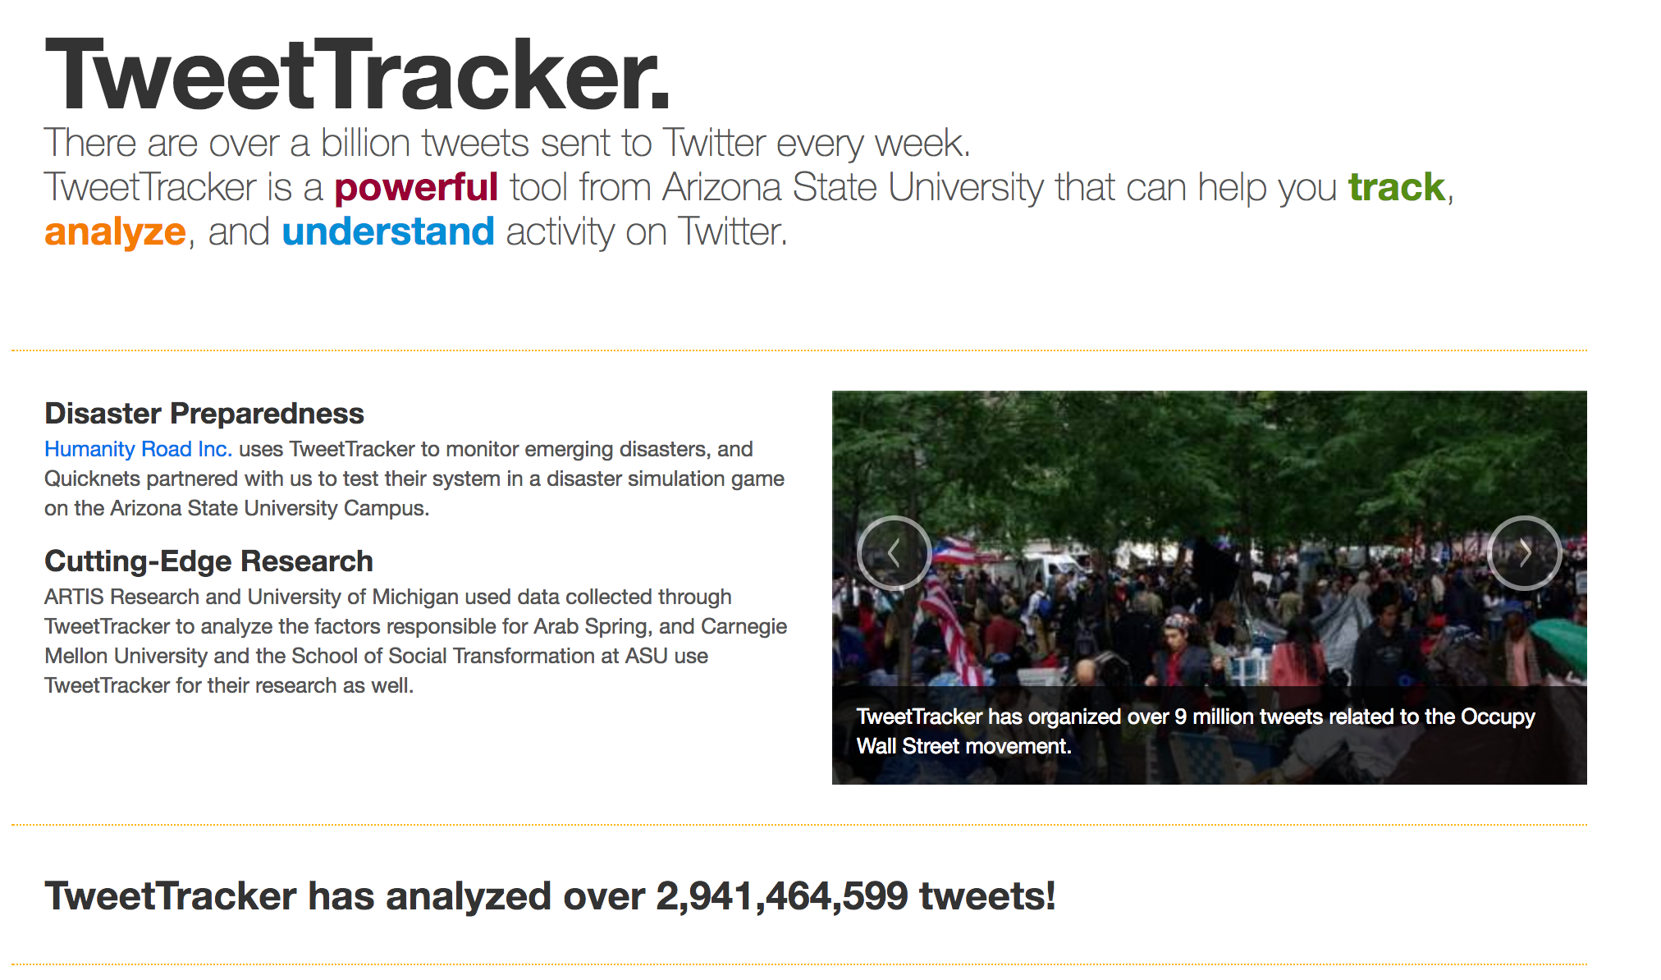
Data Crawling

Slide 7
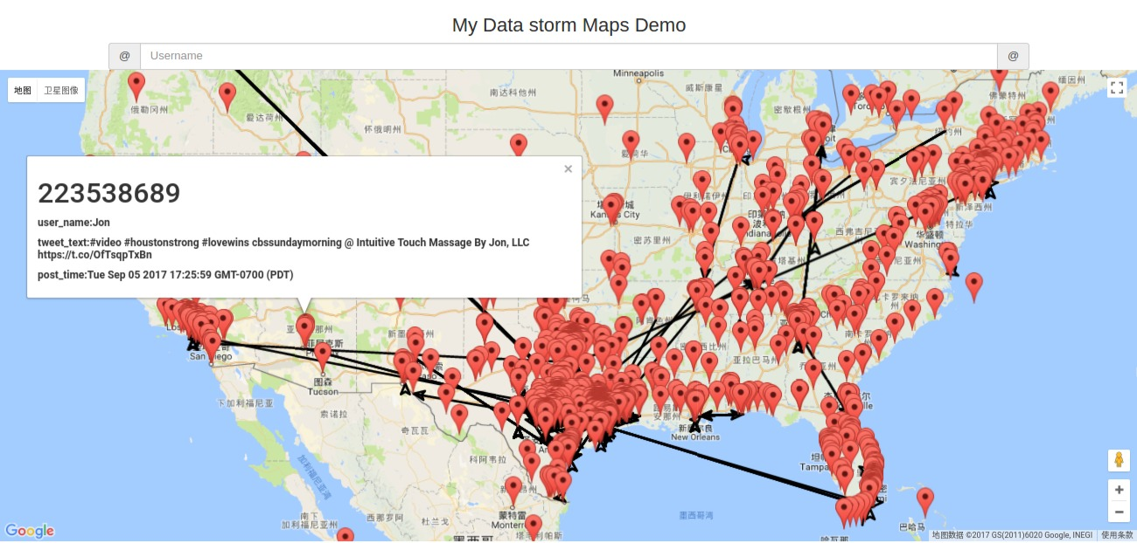
Location Estimation
Harvey Hurricane
Location Information Overview
The geo-tagged tweets shown in the map during the time of Harvey hurricane,
but what about those tweets without geo-tag?

Slide 8
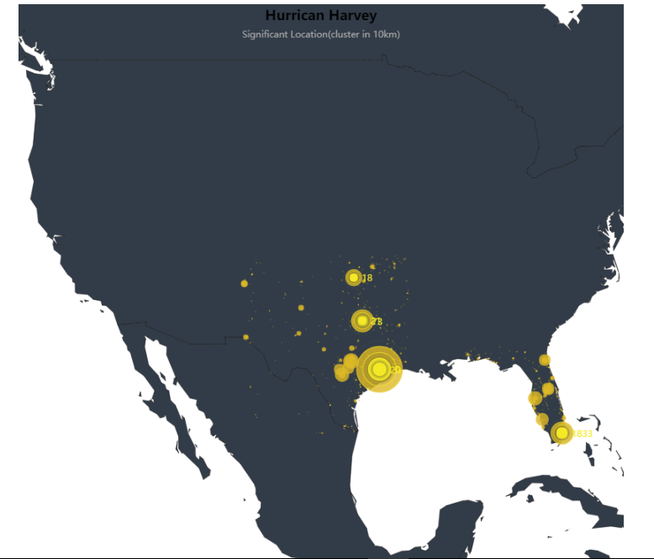
Significant Location
Data from Texas and Florida
The yellow point shows some significant spots in the map.
The bigger the spot is, the more important that place is.

Slide 9
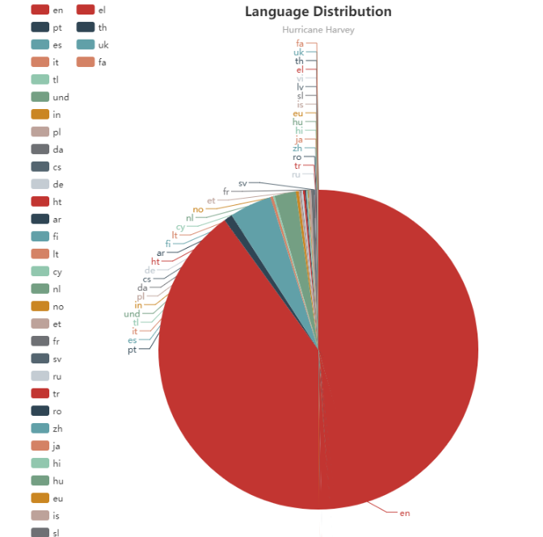
Language Distribution
English covered the largest the portion.
Spanish is the second largest portion.

Slide 10
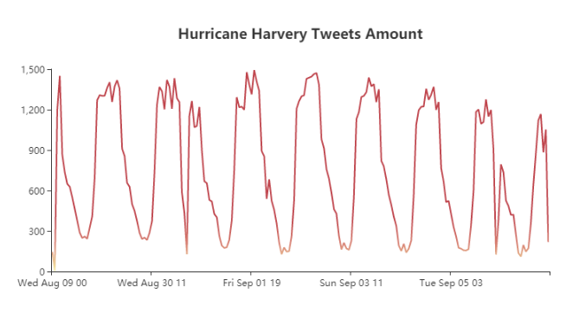
Temporal information
The tweet data distribution based on the time

Slide 11
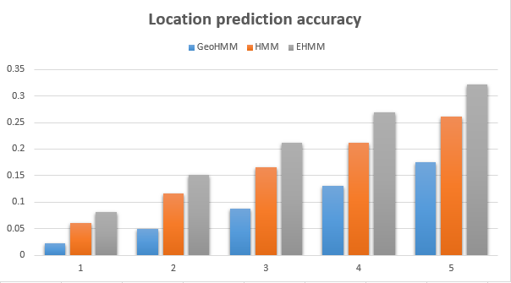
Location Estimation
The accuracy climbs up with the different numbers of K state and different prediction method.

Slide 12

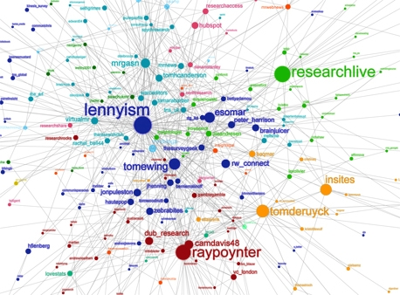
SOCIAL NETWORK

HIGHLIGHTS
Then how do make it come true?
Friend prediction is based on text similarity and interaction frequency.
location is inferenced from friend’s geo-tagged tweets.
Features
Regression Decision Tree
Belief Propagation
Dynamic Bayesian Network

Slide 13
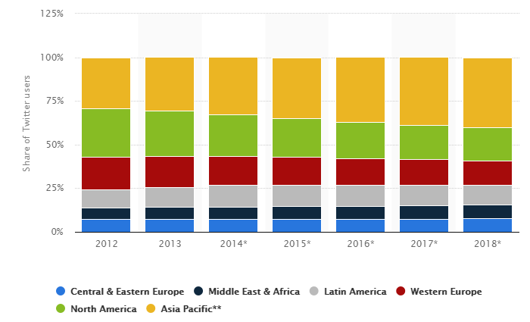
Machine Translation

Slide 14

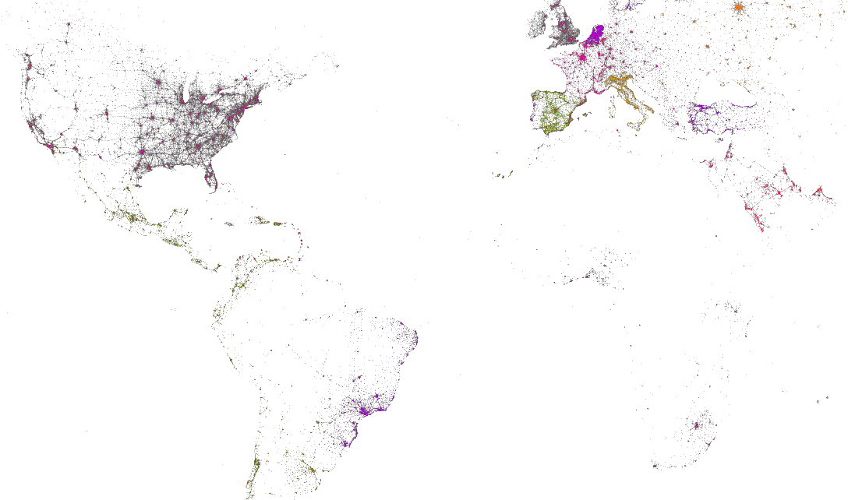
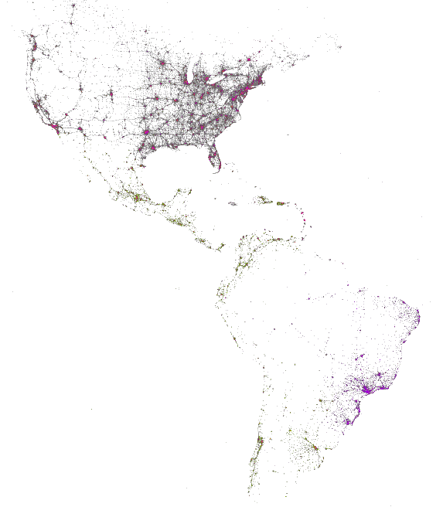
Languages On Twitters

Slide 15

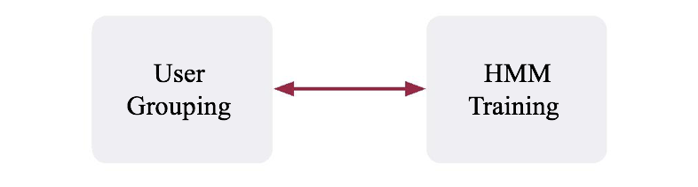
Human Mobility Model
:An Iterative Process
• GMove alternates between user grouping and HMM training.
• HMM Training
‣
‣
Assume the group memberships of diﬀerent users are ﬁxed
Learn one HMM for each group g
• User Grouping
‣
‣
Assume the HMMs of diﬀerent groups are already learnt
For user u, update the membership vector by computing the posterior probability
that u belongs to group g
10

Slide 16
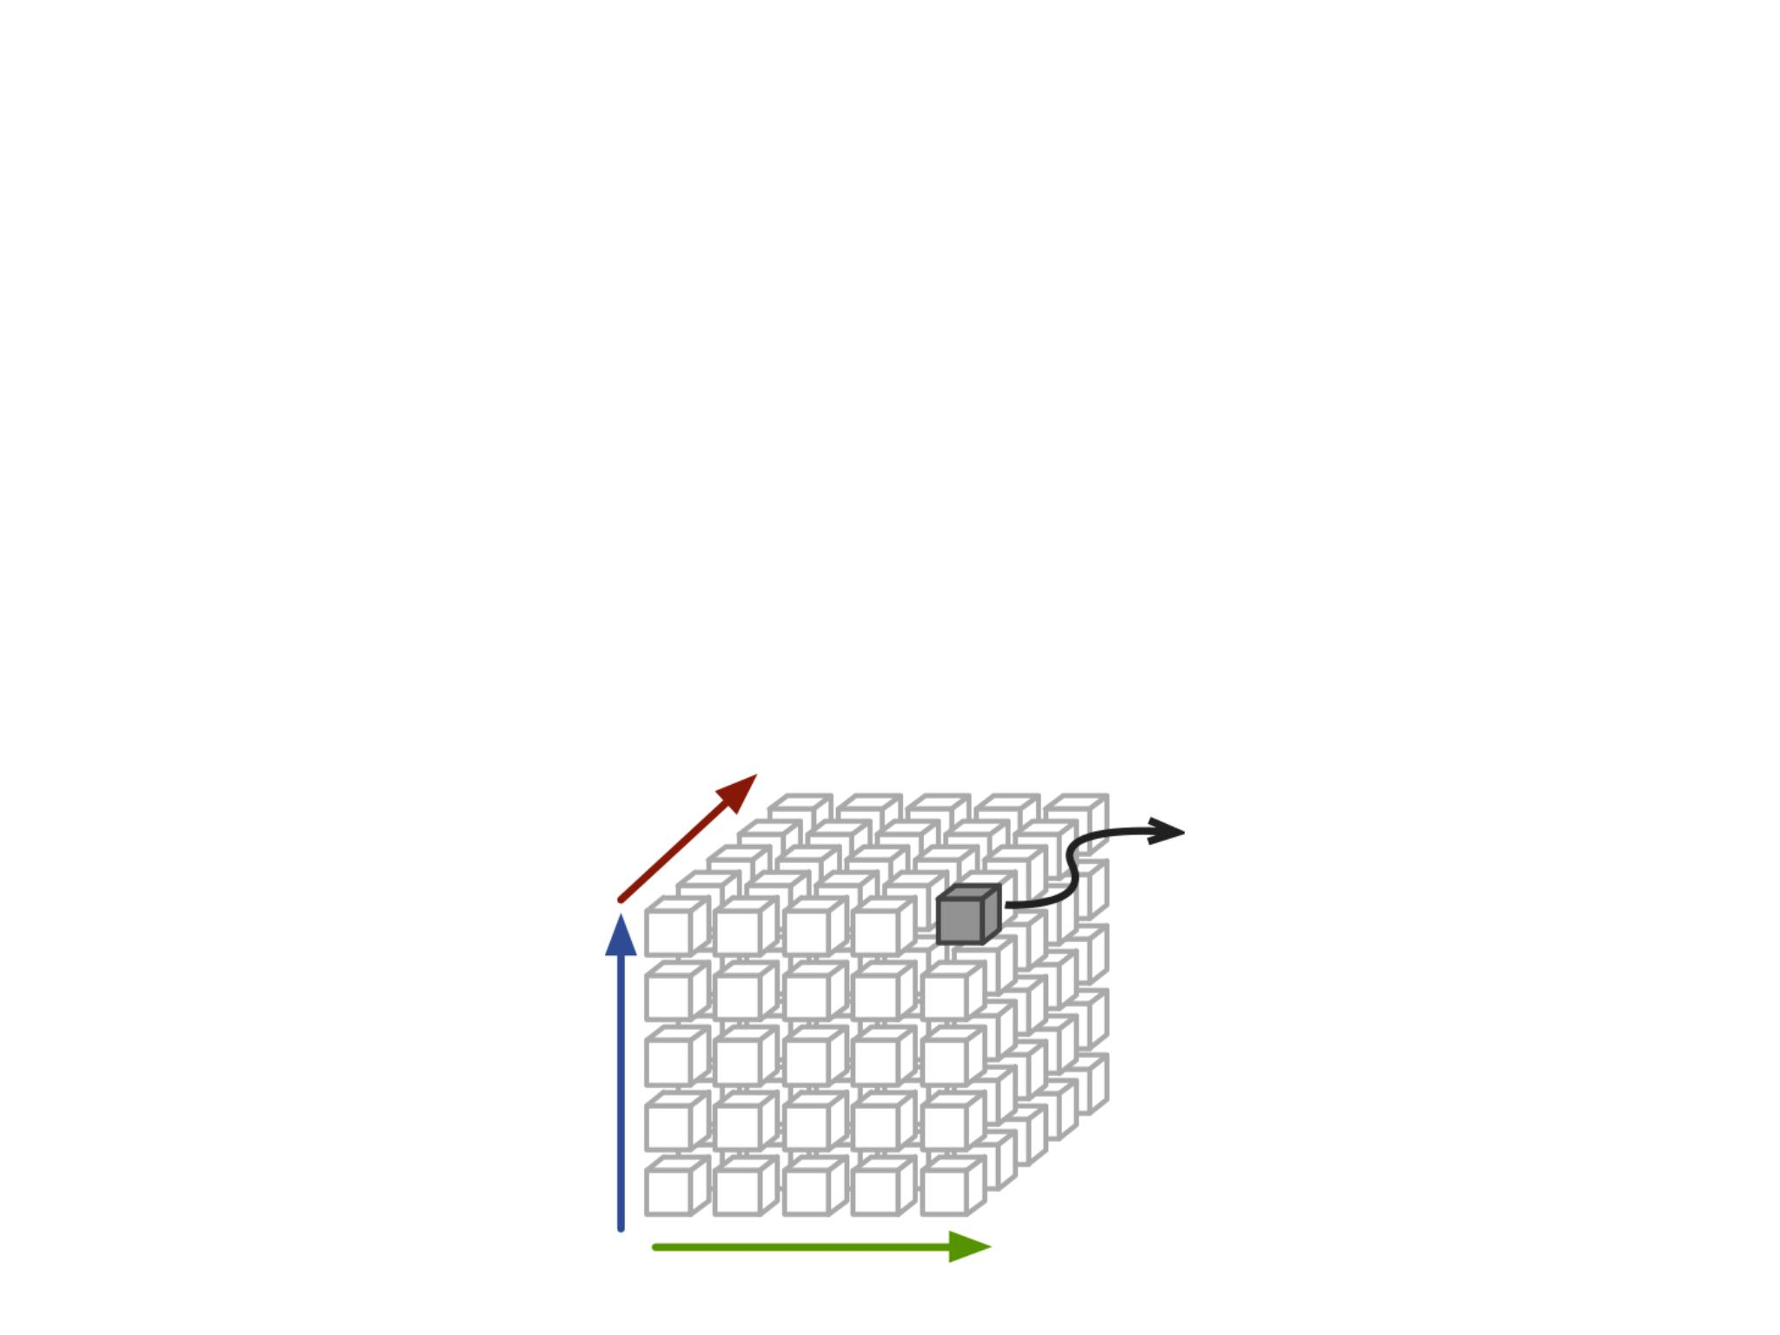
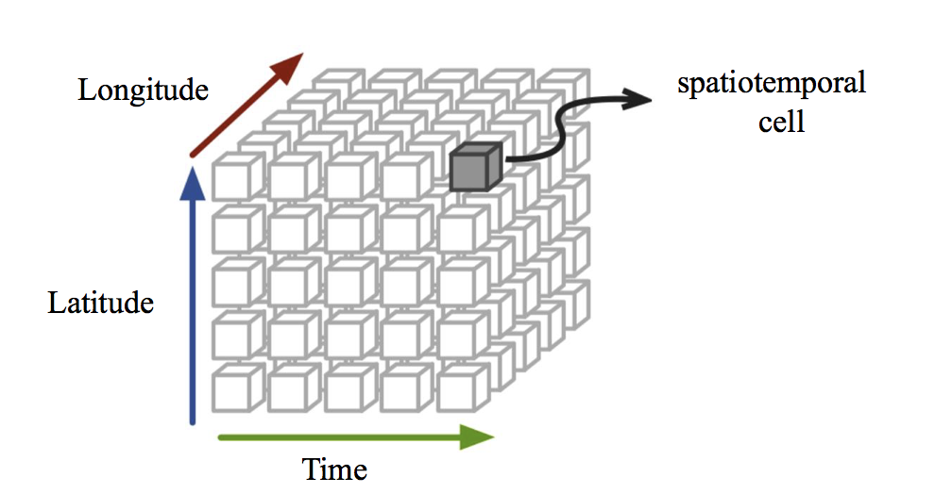
Text Augmentation
• We discretize the space D into equal-size cells.
‣
For each keyword k, we use its spatiotemporal distribution over
the 3-D cube to obtain a vector V .
k
‣
Given two keywords, we compute their correlation as the cosine
distance between their vectors.
Time
12

Slide 17
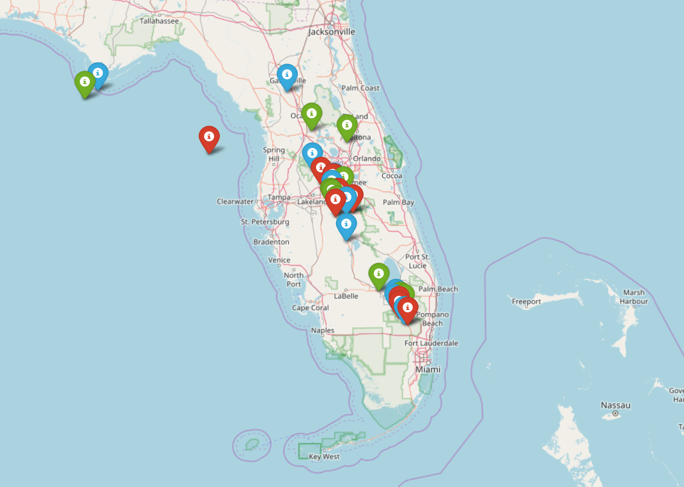
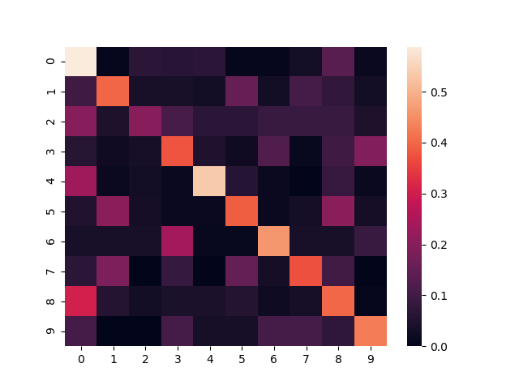
Results

Slide 18
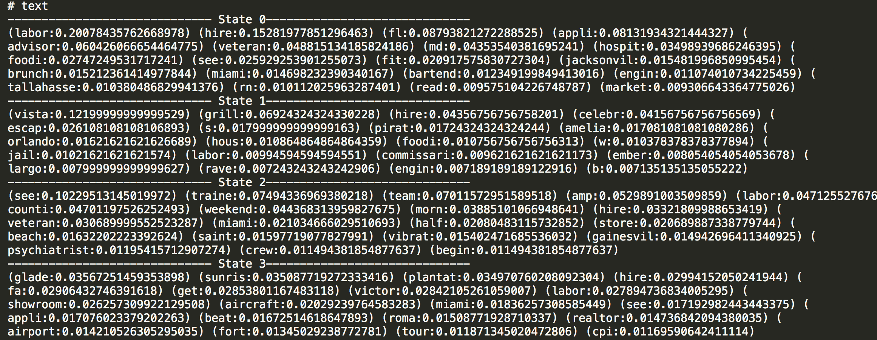
Results

Slide 19
Task Assignment

Slide 20
Q&A

